Slide 1
Mastering PL/SQL Programming
Exceptions, Logging, Debugging and Standards/Documentation

Slide 2
Agenda
Instrumentation
  Logging & Notifications
  Debugging
  Exceptions
PL/SQL Standards

Slide 3
Best Practices
A word about “best practices”…
  Simple
  Re-usable
  Robust
  Documented
  Tested
Programming and problem-solving should be fun!

Slide 4

Does this resemble your typical day?

Slide 5

Or this?

Slide 6
Agenda
Instrumentation
  Logging & Notifications
  Debugging
  Exceptions
PL/SQL Standards

Slide 7
Instrumentation
Think of Oracle’s Enterprise Manager
A car’s dashboard
A plane cockpit
Windows process explorer
A telco’s network operations center

Slide 8
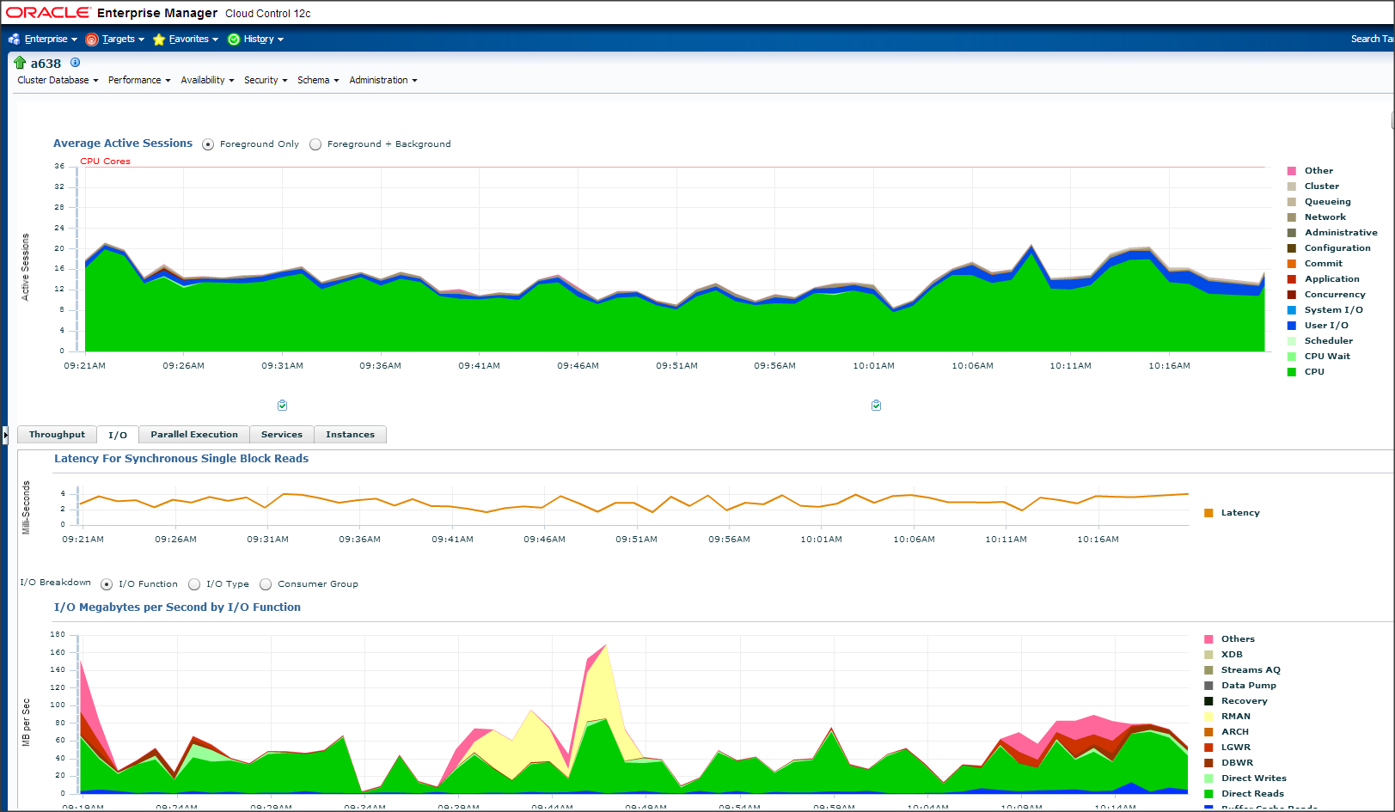
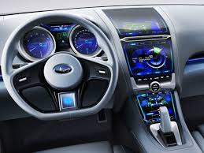
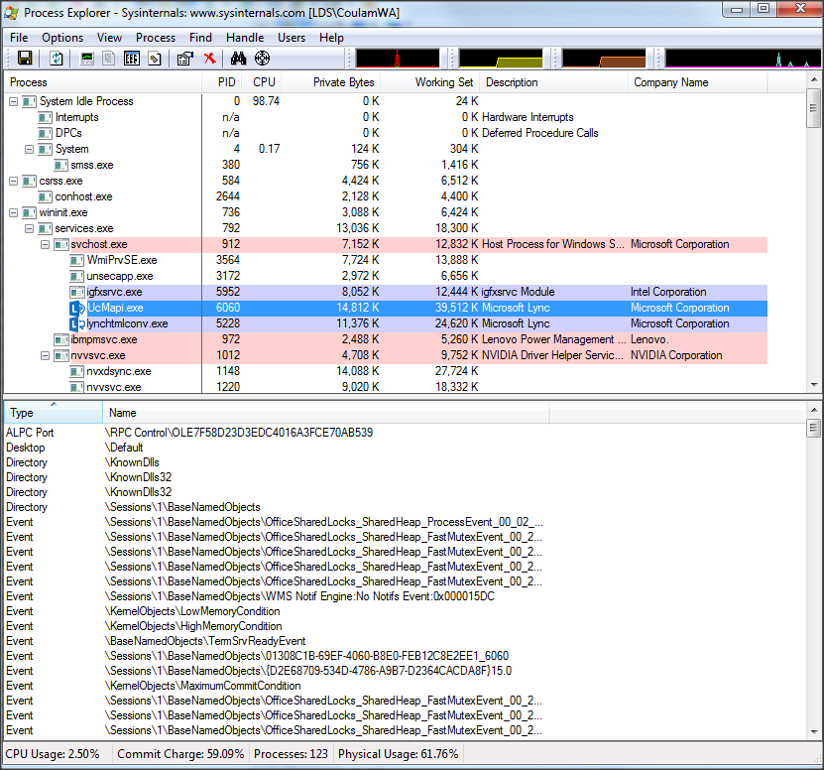
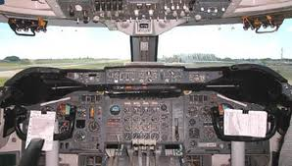
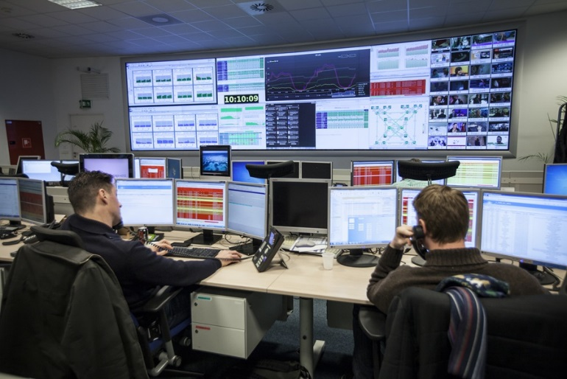
Instrumentation – Physical World
  They all provide real-time, valuable insight into the inner workings of complex systems.

Slide 9





Instrumentation – Typical Custom PL/SQL
  No insight into the inner workings of complex systems.

Slide 10
Instrumentation
I define it as the act of fitting production applications with code that directs runtime context to some destination where it can be useful.

Slide 11
Instrumentation – Runtime Context
Who
  Name of called routine
  Metadata of caller
What
  Parameters passed or read, current variable values, counters
When
What changed
Metrics (timings and counts)
Exceptions, warnings
Landmarks and breadcrumbs

Slide 12
Instrumentation – Runtime Context Buckets
Logging – Permanently enabled messages generated by the code at runtime, logging valuable information the business may require. This information is typically larger-grained than the detailed debug messages, such as when a critical process started and stopped and how long it took (metrics), or warnings and errors detected and the values being processed at the time of the error.
Debugging – Lots of highly detailed messages that, when enabled, can show a troubleshooter the exact path a call took and all the parameter and variable values experienced during execution. Due to sheer volume, debug messages are typically disabled in production code, but can be dynamically enabled by changing a table-based or application context-based key value.
Auditing – Data that exposes who changed what and when it was done. The audit data can be mixed in with the debug and log messages, but I’ve found it handy to keep audit data separate in a table set designed for tracking changes to rows and columns.

Slide 13
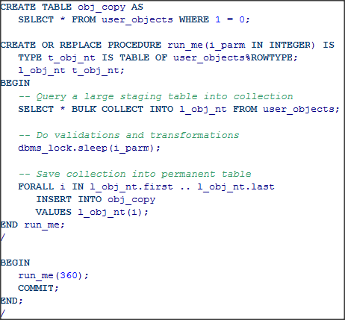
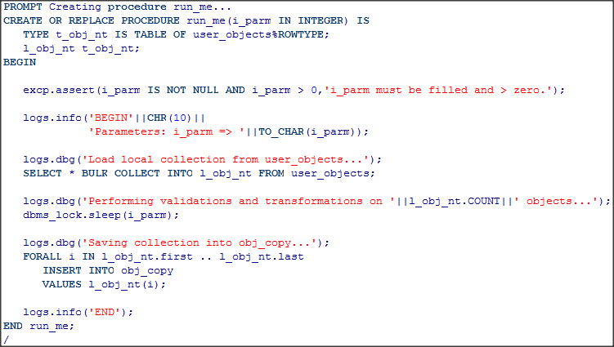
Instrumentation – Runtime Context Example
While this is running, where can you go to figure out what it is doing?
With instrumentation, query logging table to see where it is at.

Slide 14
Instrumentation
The act of fitting production applications with code that directs
runtime context to some destination where it can be useful.

Slide 15
Instrumentation - Destinations
Destination | Built-in Library
stdout/screen | dbms_output, dbms_debug (via app)
[G]V$ views | dbms_application_info, dbms_session
File on DB host | utl_file
Queue (for asynch redirection) | dbms_aq
DBMS Pipe | dbms_pipe
DBMS Alert | dbms_alert
Alert Log | dbms_system
Various Web endpoints (including email) | utl_http, utl_tcp, utl_smtp, utl_mail
Logging Table | none (build or adopt)

Slide 16
Agenda
Instrumentation
  Logging & Notifications
  Debugging
  Exceptions
PL/SQL Standards

Slide 17
Logging and Notifications
Errors
Warnings
Information Only
Metrics
Proactive Monitoring

Slide 18
Logging and Notifications - Requirements
Destination Choice
  Minimally: to table and screen
  Optionally: to file
  Nice to have: ftp, pipe, AQ, http, etc.
  Output must be transaction-independent
Dynamic Logging
  Controlled by toggles kept in a table, file or application context
Simplicity
  Simple to record runtime context to a configurable destination
  Simple to handle, log and re-raise exceptions
  Simple to drop breadcrumbs in V$ performance views
  Client and session metadata should be gathered for you

Slide 19
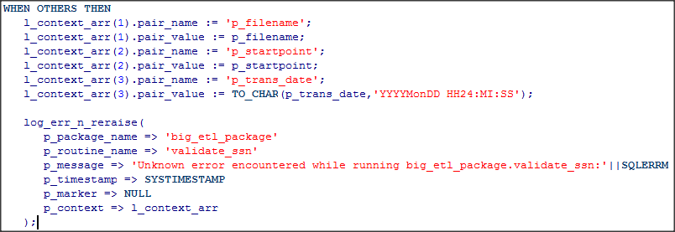
Logging and Notifications - Simplicity
Follows good practices, but I wouldn’t want to use it more than about three times.

Slide 20
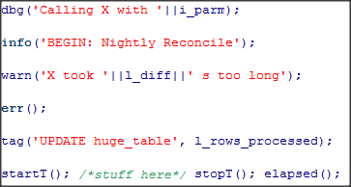
Logging and Notifications - Simplicity
Ah, look how simple and easy it is to call those functions. I can do that!

Slide 21
Agenda
Instrumentation
  Logging & Notifications
  Debugging
  Exceptions
PL/SQL Standards

Slide 22
Debugging
What is debugging?
Why do we debug?
How do you debug and do firefighting today?
When you have to debug, what is the ideal scenario?
  Dynamic: Can be turned on and off
    Debug instrumentation can remain in Prod code
    Turn on for a PL/SQL unit, session, named process, end user, IP address, etc.
  Visible immediately. No waiting.
  Output choice: file, table, screen, other?
  Painless for developers to learn and use
  Auto-report time and origination
Notes:
DBMS_OUTPUT.put/put_line:
Built-in. Easiest to remember and use. Fine for quick and dirty anonymous blocks. But…
Unpleasant to type over and over.
Goes to buffer, which in most tools is not fetched until the end of the block, after it’s too late to catch the bug in play, forcing at least one more debugging attempt.
If used in production troubleshooting, front end must fetch from the buffer to benefit. Most do not, and the output is lost to the Oracle aether.
If added to troubleshoot production, packages must be compiled, forcing invalidations, downtime, disgruntled users/customers.
Until 10g, severely limited to <= 255 characters. (32K limit now)
Logging to file:
Output is immediately visible. No need for anonymous transaction. But…
Must be designed for security and file system constraints.
If left in production, can quickly fill disk, so most opt to be very conservative, leaving little useful info when troubleshooting is required.
Logging to table:
Output immediately visible if within anonymous block.
If left in production, can quickly fill tablespace, so again logging is kept conservative.
GUI tool:
Most can only attach to new backend session, not an existing or client-side session.
Code must be compiled in prod with debug tokens.
I’ve seen these tools mess up the sessions, where it had to be killed externally and in the OS to clean it up. Risks running in Production.
DBMS_DEBUG is used under the covers of these tools. Too complex and low-level to use manually. Limitations with collections, which you should be using gratuitously.

Slide 23
Debugging Output Choices
DBMS_OUTPUT
Log to file
Log to table
GUI tool or DBMS_DEBUG API
Demo of Oracle Debug API
Demo of Dynamic Debugging

Slide 24
Agenda
Instrumentation
  Logging & Notifications
  Debugging
  Exceptions
PL/SQL Standards

Slide 25
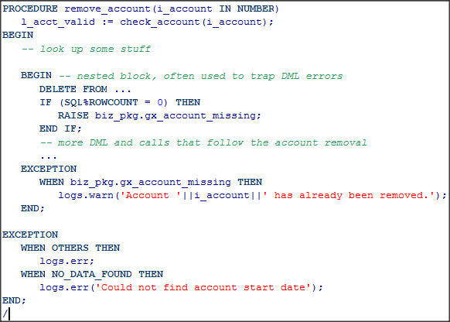
Exceptions – The Rules
Any PL/SQL block can have an exception section
Each exception section can have 1 to N exception handlers
A raised exception transfers control to nearest exception section
After matching handler runs, control transfers to next statement in the enclosing block
If no handler, the exception “bubbles” up to the caller
If exception from block declaration section, will bubble up w/o visiting matching handler.
DML in routines that end with an unhandled exception are automatically rolled back*
Bad
Bad
* Despite what the 11g docs say

Slide 26
Exceptions – Types
Internally Defined
  PLS-00049 to PLS-01918
  ORA-00000 to ORA-64621
  See http://docs.oracle.com/cd/E11882_01/server.112/e17766/toc.htm
Predefined
  Oracle wrapped 22 of their internally defined errors with names
  Most commonly used: NO_DATA_FOUND, DUP_VAL_ON_INDEX, and TOO_MANY_ROWS
User-defined
  Exception named by the developer.
  Must be raised explicitly, unless tied to internally defined error
  Tied with PRAGMA EXCEPTION_INIT(<exception>, <error number>)
  Names best kept in a package specification

Slide 27
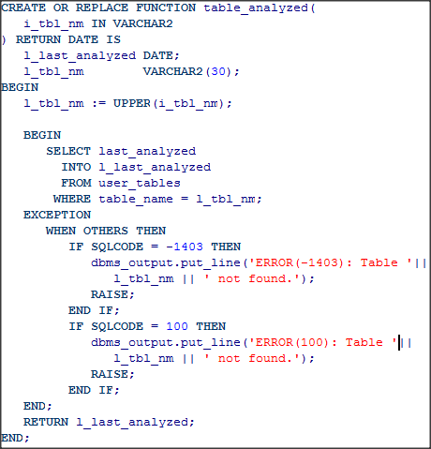
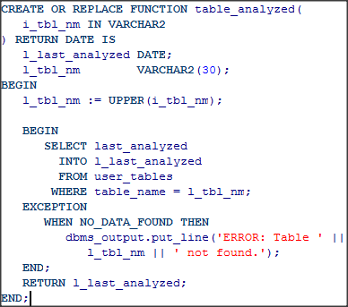
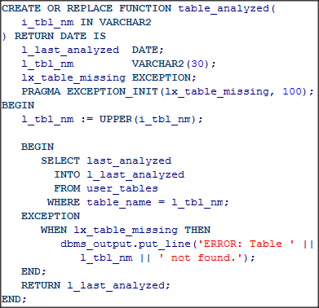
Exceptions – Types
Internally Defined
Predefined
User Defined
Bad
Better
Best
Bad but correct

Slide 28
Exceptions - Raising
RAISE
  Inside an exception handler, mostly used by itself to re-raise the trapped exception once it has been “handled”
  Outside an exception handler, used to spawn the exception and requires an exception name.
RAISE_APPLICATION_ERROR
  Used to raise user-defined exceptions tied to user-defined messages
  Error number must be in the range -20000 to -20999
  Message limited to 2048 bytes
  Only common exception library should use it, not developers.

Slide 29
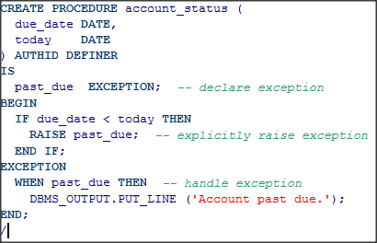
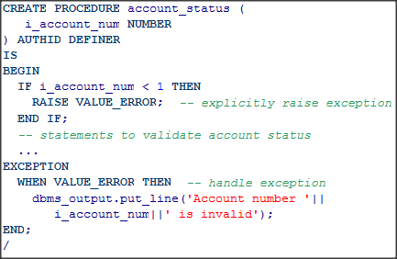
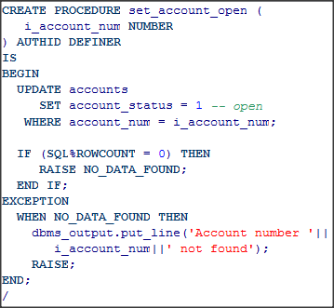
Exceptions - Raising
RAISE User Defined
RAISE Predefined
Re-RAISE

Slide 30
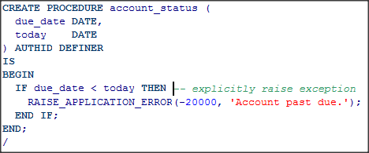
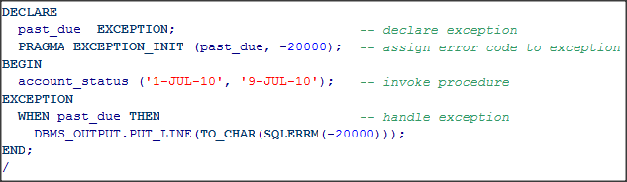
Exceptions - Raising
Raising user-defined exception
Trapping and handling user-defined and raised exception

Slide 31
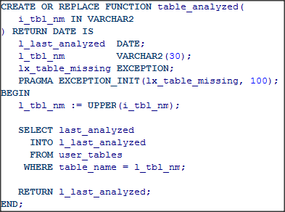
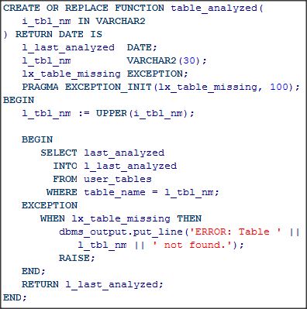
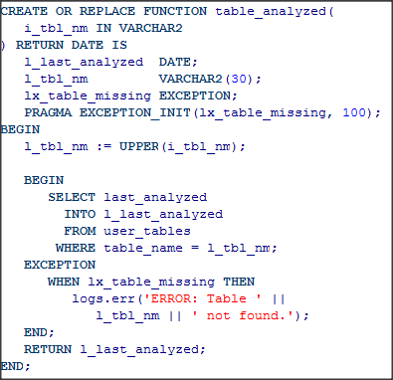


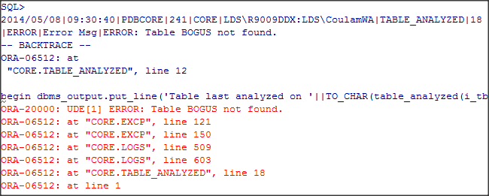
Exceptions – Handling them loses information
NO_DATA_FOUND unhandled
NO_DATA_FOUND handled
Handled with logging library
Where the error was raised. NOT where the error happened
Exact point of error generation
Can finally see original point of error again

Slide 32
Exceptions – SQLCODE and SQLERRM
SQLCODE returns the error number
SQLERRM returns the full error message associated with the error number.
Developers shouldn’t be using these directly. Only used within your common logging and exception handling library.

Slide 33
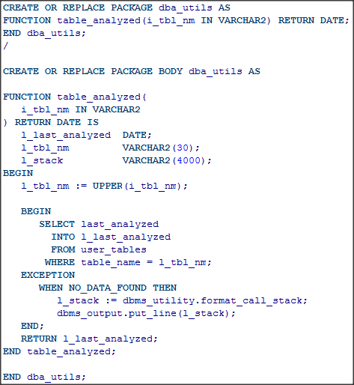
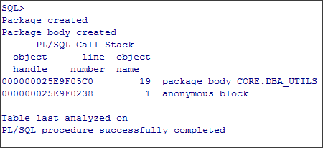
Exceptions – Call Stack

Slide 34
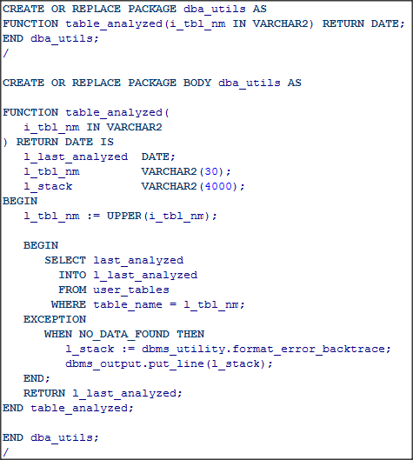
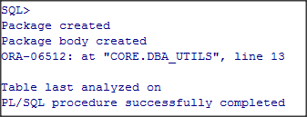
Exceptions – Backtrace Error Stack

Slide 35
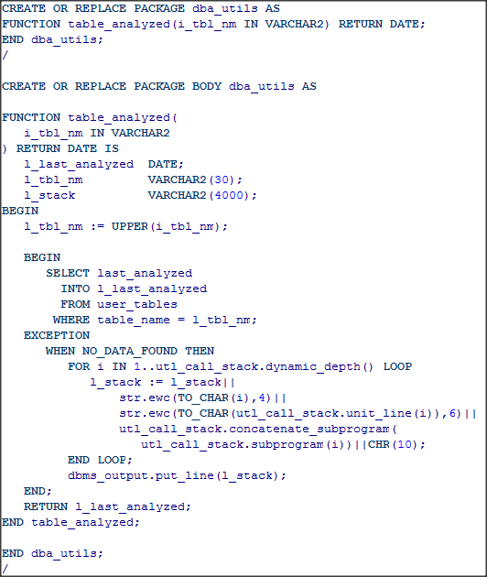
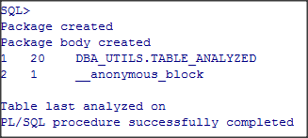
Exceptions – 12c Call Stack

Slide 36
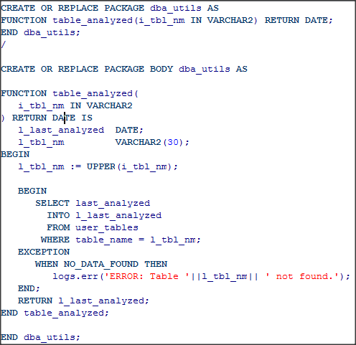
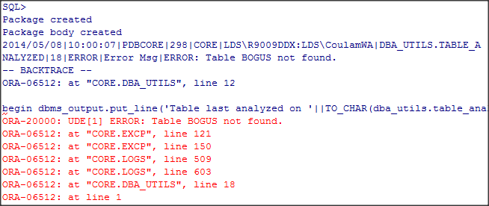

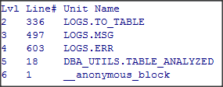

Exceptions – All Stacks using logging pkg
app_log.log_txt
app_log.call_stack
app_log.error_stack

Slide 37
Exceptions – Best Practices
Keep your routine small and simple
Use assertions to test assumptions
Only handle anticipated errors with an exception
  Use a standard method of logging and re-raising
  Do not use parameters to communicate execution status
  Do not use WHEN OTHERS. If you must, ensure you re-raise the exception.
Allow PL/SQL’s default exception and rollback model to handle everything else.

Slide 38
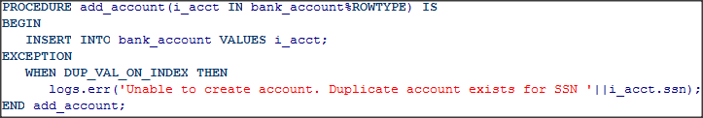
Exceptions – Small and Simple Routines
Simple routines do one thing well
Simple routines usually don’t need any exception handlers
If they do, it is usually just one, focused exception

Slide 39
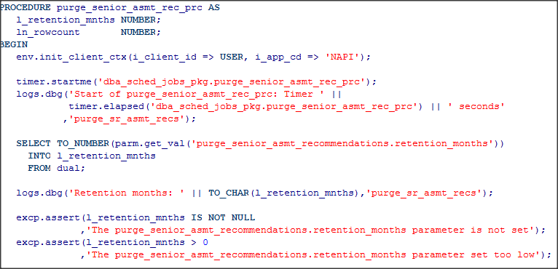
Exceptions – Check Your Assumptions
Assertions codify “tribal memory”
Things you currently “know” or assume about the business process, the environment, the caller, the parameter values, etc. should all be carved in stone with assertions.
Older development paradigms call this “coding by contract”

Slide 40
Resource Name | License | Purpose | Location & Notes
Google Code | Free | Library of libraries | http://code.google.com/hosting/search?q=label:plsql
Feuerstein's PL/SQL Obsession | Free | Repository of all things SF and PL/SQL | http://www.toadworld.com/sf
QCGU (Quest CodeGen Utility) | Free | Full framework Standards, Scripts, Template Factory, Code Generation, + more | http://codegen.inside.quest.com/index.jspa
 |  |  | Latest incarnation of Feuerstein's vast reservoir of experience. (successor of QXNO, PL/Vision, and PL/Generator.)
PL/SQL Starter | Free | Author's full framework. | http://sourceforge.net/projects/plsqlframestart
Simple Starter | Free | Logging, Timing, Auditing, Debugging, Error Handling, + more | Simplified PL/SQL Starter to just logging, timing and auditing components (and the low-level packages they depend on). Designed to be used in one schema. Install and begin using in under a minute.
GED Toolkit | $120-$1200 | Almost full framework | http://gedtoolkit.com
 |  |  | Includes APEX UI to administer jobs and tables. Monitor processing.
PL/Vision | Free | Framework, API Generator, + more | http://toadworld.com/Downloads/PLVisionFreeware/tabid/687/Default.aspx
 |  |  | Replaced by QXNO and then QCGU. Not supported.
Log4ora | Free | Logging | http://code.google.com/p/log4ora/
 |  |  | Fresh, full-featured logging library. Alerts. AQ. Easy to use. Good stuff.
ILO | Free | Timing and Tuning | http://sourceforge.net/projects/ilo
 |  |  | From the sharp minds at Hotsos
Quest Error Manager | Free | Error Handling | http://www.toadworld.com/LinkClick.aspx?link=685&tabid=153
 |  |  | Included in QCGU. But offered separately as well. Not supported.
Plsql-commons | Free | Collection of utilities, including logging | http://code.google.com/p/plsql-commons
Log4oracle-plsql | Free | Logging | http://code.google.com/p/log4oracle-plsql
 |  |  | Seems like an active project, but could not find code to download…
Log4PLSQL | Free | Logging | http://sourceforge.net/projects/log4plsql
 |  |  | Popular, but aging and complex log4j analog in PL/SQL
Logger | Free | Logging | http://sn.im/logger1.4
 |  |  | Recently orphaned when Oracle decommissioned its samplecode site. Simple. Easy to use.
Orate | Free | Logging | http://sourceforge.net/projects/orate
 |  |  | Never used it, but has been around a while. Still active.
Existing
Instrumentation
Libraries

Slide 41
Starter and Simplified Starter
Library | Main Routines | Supporting Components and Notes
Auditing: gen_audit_triggers.sql |  | APP_CHG_LOG, APP_CHG_LOG_DTL (tables)
Metrics: TIMER (package) | startme() stopme() elapsed() | Uses DBMS_UTILITY
Debugging, Logging and Error Handling: LOGS (package) EXCP (package meant to be used only by LOGS) APP_LOG_API (pkg meant to be used only by LOGS) | err() warn() info() dbg() | APP_LOG (table) TRIM_APP_LOG (scheduled job)
Connection Metadata: ENV (package) | init/reset_client_ctx() tag/untag() tag_longop() | Uses DBMS_DB_VERSION, DBMS_APPLICATION_INFO, DBMS_SYSTEM, v$session and v$mystat.
File Operations: IO (meant to be used primarily by LOGS) | write_line() write_lines(0 p() | Uses UTL_FILE, DBMS_LOB
Dynamic (Table-Driven) Parameters/Properties: PARM (package) | get_val() | APP_PARM (table)
Extras (required for the seven libraries above to function): CNST, TYP, DDL_UTILS, DT, STR, NUM (packages) | These are libraries of application-wide constants and subtypes, build utility functions; date, string and number manipulation routines.

Slide 42
Agenda
Instrumentation
  Logging & Notifications
  Debugging
  Exceptions
PL/SQL Standards

Slide 43
PL/SQL Standards
Write it or adopt it or blend it
  Google “PL/SQL Standards”. Take the ToadWorld link.
  http://www.toadworld.com/platforms/oracle/w/wiki/8245.plsql-standards.aspx
Ensure it is followed
  Automated formatting
  Automated snippets, frequent SQL, frequent PL/SQL
  Shared templates
  Peer review
  Configurable standards checker (like Dell’s CodeXpert in Toad)

Slide 44
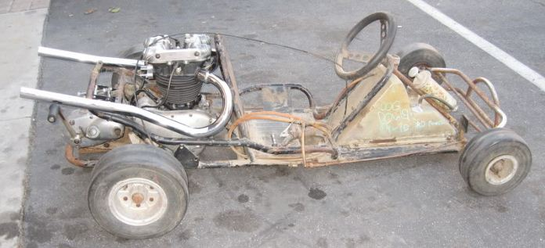

How is your craftsmanship perceived?
vs.

Slide 45
Conclusion
Coding and problem solving should be fun, not tedious and painful.
Standards, instrumentation and a common exception handling method are a large part of that goal.
Whether you adopt, hybridize or build your own common libraries they must be simple and easy to use.
Instrumentation is the “low-hanging fruit” because it can be added easily after production rollout.
  Modifying existing code format and exception handling is not as easy, but can be tackled incrementally, one package at a time during maintenance activities.
Ensure their use through peer reviews, automation, rewards and some good old public flogging and humiliation ;-)
Get started today! It’s easy.

Slide 46
Questions?
Contact: bcoulam@yahoo.com
Papers and Code:
  http://www.dbartisans.com
Framework: http://sourceforge.net/projects/plsqlframestart

